Slide 1

Chapter 4
Digital Transmission
4.<number>
Copyright © The McGraw-Hill Companies, Inc. Permission required for reproduction or display.

Slide 2
4-1 DIGITAL-TO-DIGITAL CONVERSION
In this section, we see how we can represent digital data by using digital signals. The conversion involves three techniques: line coding, block coding, and scrambling. Line coding is always needed; block coding and scrambling may or may not be needed.
Topics discussed in this section:
Line Coding
Line Coding Schemes
Block Coding
Scrambling
4.<number>

Slide 3

Figure 4.1 Line coding and decoding
Line coding is the process of converting digital data to digital signals. We assume that data, in the form of text, numbers, graphical images, audio, or video, are stored in computer memory as sequences of bits. Line coding converts a sequence of bits to a digital signal. At the receiver, the digital data are recreated by decoding the digital signal.
4.<number>

Slide 4

Signal element versus data element
Recall that digital signal is a sequence of discrete, discontinuous voltage pulses.
Each pulse in digital signal is a signal element.
Binary data are transmitted by encoding each data bit into signal elements.
1
0
1
0
1
0
There can be one-to-one correspondence between data elements and signal elements or one-to-multiple/multiple-to-one

Slide 5

Figure 4.2 Signal element versus data element
In digital data communication, a signal element carries data elements. We define a ratio “r” , which is the number of data elements carried by each signal element.
4.<number>

Slide 6
Bit Rate VS Baud Rate
Data rate: The data rate defines the number of data elements (bits) in 1sec. The unit is bits per second (bps).
Signal rate: The signal rate is the number of signal elements in 1sec. The unit is baud.
Note: The data rate is sometimes called the bit rate; the signal rate is sometimes called the pulse rate, the modulation rate, or the baud rate.
Bit Rate: Number of bits transmitted during one second.
Baud Rate: Number of signal units/elements per second that are required to represent that bit.
OR
Modulation rate: The rate at which signal element is changed and is expressed in baud i.e. signal elements/second
To measure the efficiency of computer we use bit rate.
To measure the efficiency of a data communication system we use baud rate.
Example: An analog signal carries 4 bits in each signal element. If 1000 signal elements are sent per second, find the baud rate and bit rate?
    Baud rate = number of signal elements per second
    _{Baud rate = 1000 bauds}
    Bit rate = baud rate * number of bits per signal element
    _{Bit rate = 1000 * 4 = 4000 b/s}

Slide 7
Three Cases
The relationship between the data rate (N) and signal rate (S) is
S=N/r
This relationship, of course, depends on the value of r. It also depends on the data pattern. If we have a data pattern of all 1s or all 0s, the signal rate may be different from a data pattern of alternating 0s and 1s.
To derive a formula for the relationship, we need to define three cases: the worst, best, and average.
The worst case is when we need the maximum signal rate;
The best case is when we need the minimum signal rate;
In data communications, we are usually interested in the average case. Thus, the relationship between data rate and signal rate as
S_{avg} = c * N * 1/r baud
where N is the data rate (bps); c is the case factor, which varies for each case; S is the number of signal elements per second;

Slide 8

Example 4.1
A signal is carrying data in which one data element is encoded as one signal element ( r = 1). If the bit rate is 100 kbps, what is the average value of the baud rate if c is between 0 and 1?
Solution
We assume that the average value of c is 1/2 . The baud rate is then
4.<number>

Slide 9

Note
Although the actual bandwidth of a digital signal is infinite, the effective bandwidth is finite.
4.<number>

Slide 10

Example 4.2
The maximum data rate of a channel (see Chapter 3) is Nmax = 2 × B × log₂ L (defined by the Nyquist formula). Does this agree with the previous formula for N_{max}?
Solution
A signal with L levels actually can carry log₂L bits per level. If each level corresponds to one signal element and we assume the average case (c = 1/2), then we have
4.<number>

Slide 11

Figure 4.3 Effect of lack of synchronization
4.<number>

Slide 12
Example 4.3
In a digital transmission, the receiver clock is 0.1 percent faster than the sender clock. How many extra bits per second does the receiver receive if the data rate is
1 kbps? How many if the data rate is 1 Mbps?
Solution
At 1 kbps, the receiver receives 1001 bps instead of 1000 bps.
At 1 Mbps, the receiver receives 1,001,000 bps instead of 1,000,000 bps.
4.<number>

Slide 13

Figure 4.4 Line coding schemes
4.<number>

Slide 14

Figure 4.5 Unipolar NRZ scheme
In a unipolar scheme, all the signal levels are on one side of the time axis, either above or below.
NRZ (Non-Return-to-Zero): Traditionally, a unipolar scheme was designed as a non-return-to-zero (NRZ) scheme in which the positive voltage defines bit 1 and the zero voltage defines bit 0. It is called NRZ because the signal does not return to zero at the middle of the bit.
Compared with its polar counterpart (see the next section), this scheme is very costly. As we will see shortly, the normalized power (the power needed to send 1 bit per unit line resistance) is double that for polar NRZ. For this reason, this scheme is normally not used in data communications today.
4.<number>

Slide 15

Figure 4.6 Polar NRZ-L and NRZ-I schemes
In polar schemes, the voltages are on both sides of the time axis. For example, the voltage level for 0 can be positive and the voltage level for 1 can be negative.
In polar NRZ encoding, we use two levels of voltage amplitude. We can have two versions of polar NRZ: NRZ-L and NRZ-I, as shown in Figure 4.6. The figure also shows the value of r, the average baud rate, and the bandwidth. In the first variation, NRZ-L (NRZ-Level), the level of the voltage determines the value of the bit. In the second variation, NRZ-I (NRZ-Invert), the change or lack of change in the level of the voltage determines the value of the bit. If there is no change, the bit is 0; if there is a change, the bit is 1.
In NRZ-L the level of the voltage determines the value of the bit. In NRZ-I the inversion or the lack of inversion determines the value of the bit.

Slide 16
DC Components
When the voltage level in a digital signal is constant for a while, the spectrum creates very low frequencies (results of Fourier analysis). These frequencies around zero, called DC (direct-current) components, present problems for a system that cannot pass low frequencies or a system that uses electrical coupling (via a transformer). For example, a telephone line cannot pass frequencies below 200 Hz.
Also a long-distance link may use one or more transformers to isolate different parts of the line electrically. For these systems, we need a scheme with no DC component.
NRZ-L and NRZ-I both have a DC component problem.
4.<number>

Slide 17
Baseline Wandering
In decoding a digital signal, the receiver calculates a running average of the received signal power. This average is called the baseline. The incoming signal power is evaluated against this baseline to determine the value of the data element. A long string of 0s or 1s can cause a drift in the baseline (baseline wandering) and make it difficult for the receiver to decode correctly.
A good line coding scheme needs to prevent baseline wandering.
NRZ-L and NRZ-I both have baseline wandering problem, it is twice as severe in NRZ-L.
Synchronization problem (sender & receiver clocks are not synchronized) also exists in both schemes. This problem is more serious in NRZ-L than in NRZ-I.
Another problem with NRZ-L occurs when there is a sudden change of polarity resulting in all 0s interpreted as 1s and all 1s interpreted as 0s. NRZ-I does not have this problem.
4.<number>

Slide 18
NRZ-L and NRZ-I both have an average signal rate of N/2 Bd.
Example 4.4: A system is using NRZ-I to transfer 10-Mbps data. What are the average signal rate and minimum bandwidth?
Solution: The average signal rate is S = N/2 = 500 kbaud. The minimum bandwidth for this average baud rate is Bmin = S = 500 kHz.
4.<number>

Slide 19

Figure 4.7 Polar RZ scheme
Return-to-Zero (RZ): The main problem with NRZ encoding occurs when the sender and receiver clocks are not synchronized. The receiver does not know when one bit has ended and the next bit is starting. One solution is the return-to-zero (RZ) scheme, which uses three values:
positive, negative, and zero. In RZ, the signal changes not between bits but during the bit.
In Figure 4.7 we see that the signal goes to 0 in the middle of each bit. It remains there until the beginning of the next bit.
The main disadvantage of RZ encoding is that it requires two signal changes to encode a bit and therefore occupies greater bandwidth.
The problem of, a sudden change of polarity resulting in all 0s interpreted as 1s and all 1s interpreted as 0s, still exists here, but there is no DC component problem.
Another problem is the complexity: RZ uses three levels of voltage, which is more complex to create and detect. As a result of all these deficiencies, the scheme is not used today. Instead, it has been replaced by the better-performing Manchester and differential Manchester schemes
4.<number>

Slide 20

Figure 4.8 Polar biphase: Manchester and differential Manchester schemes
The idea of RZ (transition at the middle of the bit) and the idea of NRZ-L are combined into the Manchester scheme. In Manchester encoding, the duration of the bit is divided into two halves. The voltage remains at one level during the first half and moves to the other level in the second half. The transition at the middle of the bit provides synchronization.
Differential Manchester, on the other hand, combines the ideas of RZ and NRZ-I. There is always a transition at the middle of the bit, but the bit values are determined at the beginning of the bit. If the next bit is 0, there is a transition; if the next bit is 1, there is none. Figure 4.8 shows both Manchester and differential Manchester encoding.
4.<number>

Slide 21
Manchester and differential Manchester schemes
The Manchester scheme overcomes several problems associated with NRZ-L, and differential Manchester overcomes several problems associated with NRZ-I. First, there is no baseline wandering. There is no DC component because each bit has a positive and negative voltage contribution.
The only drawback is the signal rate. The signal rate for Manchester and differential Manchester is double that for NRZ. The reason is that there is always one transition at the middle of the bit and maybe one transition at the end of each bit.
Note that Manchester and differential Manchester schemes are also called biphase schemes.
In Manchester and differential Manchester encoding, the transition
at the middle of the bit is used for synchronization.
The minimum bandwidth of Manchester and differential Manchester is 2 times that of NRZ.
4.<number>

Slide 22
Bipolar Encoding
In bipolar encoding (sometimes called multilevel binary), there are three voltage levels: positive, negative, and zero. The voltage level for one data element is at zero, while the voltage level for the other element alternates between positive and negative.
The bipolar scheme was developed as an alternative to NRZ. The bipolar scheme has the same signal rate as NRZ, but there is no DC component (e.g. If we have a long sequence of 1s, the voltage level alternates between positive and negative; it is not constant. Therefore, there is no DC component. For a long sequence of 0s, the voltage remains constant, but its amplitude is zero, which is the same as having no DC component. In other words, a sequence that creates a constant zero voltage does not have a DC component.)
In bipolar encoding, we use three levels: positive, zero, and negative.
4.<number>

Slide 23

Figure 4.9 Bipolar schemes: AMI and pseudoternary
A common bipolar encoding scheme is called bipolar alternate mark inversion (AMI). In the term alternate mark inversion, the word mark comes from telegraphy and means 1. So AMI means alternate 1 inversion. A neutral zero voltage represents binary 0. Binary 1s are represented by alternating positive and negative voltages.
A variation of AMI encoding is called pseudoternary in which the 1 bit is encoded as a zero voltage and the 0 bit is encoded as alternating positive and negative voltages.
AMI is commonly used for long-distance communication, but it has a synchronization problem when a long sequence of 0s is present in the data. Later we will see how a scrambling technique can solve this problem.
4.<number>

Slide 24
Multilevel Schemes
The desire to increase the data rate or decrease the required bandwidth has resulted in the creation of many schemes.
The goal is to increase the number of bits per baud by encoding a pattern of m data elements into a pattern of n signal elements.
We only have two types of data elements (0s and 1s), which means that a group of m data elements can produce a combination of 2^{m} data patterns.
We can have different types of signal elements by allowing different signal levels. If we have L different levels, then we can produce L^{n} combinations of signal patterns. If 2^{m} = L^{n}, then each data pattern is encoded into one signal pattern.
If 2^{m} < L^{n}, data patterns occupy only a subset of signal patterns. The subset can be carefully designed to prevent baseline wandering, to provide synchronization, and to detect errors that occurred during data transmission.
Data encoding is not possible if 2^{m} > L^{n} because some of the data patterns cannot be encoded.
The code designers have classified these types of coding as mBnL, where m is the length of the binary pattern, B means binary data, n is the length of the signal pattern, and L is the number of levels in the signaling.
A letter is often used in place of L: B (binary) for L = 2, T (ternary) for L = 3, and Q (quaternary) for L = 4.
Note that the first two letters define the data pattern, and the second two define the signal pattern.
In mBnL schemes, a pattern of m data elements is encoded as a pattern of n signal elements in which 2^{m} ≤ L^{n}.
4.<number>

Slide 25
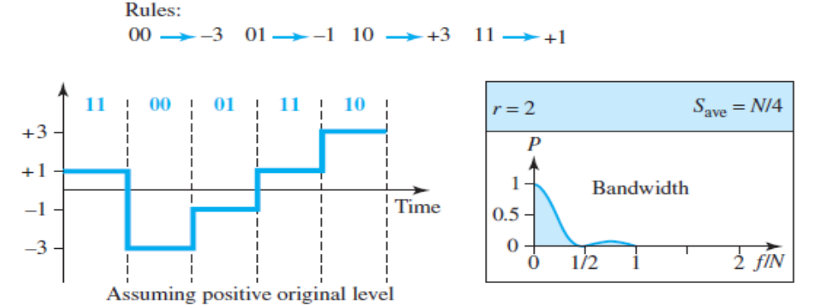
Figure 4.10 Multilevel: 2B1Q scheme
2B1Q: The first mBnL scheme, two binary, one quaternary (2B1Q), uses data patterns of size 2 and encodes the 2-bit patterns as one signal element belonging to a four-level signal. In this type of encoding m = 2, n = 1, and L = 4 (quaternary).
The average signal rate of 2B1Q is S = N/4. This means that using 2B1Q, we can send data 2 times faster than by using NRZ-L.
The 2B1Q scheme is used in DSL (Digital Subscriber Line) technology to provide a high-speed connection to the Internet by using subscriber telephone lines
4.<number>

Slide 26

Figure 4.11 Multilevel: 8B6T scheme
8B6T: A very interesting scheme is eight binary, six ternary (8B6T). This code is used with 100BASE-4T cable.
The idea is to encode a pattern of 8 bits as a pattern of six signal elements, where the signal has three levels (ternary). In this type of scheme, we can have 2⁸ = 256 different data patterns and 3⁶ = 729 different signal patterns.
There are 729 − 256 = 473 redundant signal elements that provide synchronization and error detection. Part of the redundancy is also used to provide DC balance.
Each signal pattern has a weight of 0 or +1 DC values. This means that there is no pattern with the weight −1. To make the whole stream DC-balanced, the sender keeps track of the weight. If two groups of weight 1 are encountered one after another, the first one is sent as is, while the next one is totally inverted to give a weight of −1.
4.<number>

Slide 27
Figure 4.11 Multilevel: 8B6T scheme
Figure 4.11 shows an example of three data patterns encoded as three signal patterns. The three possible signal levels are represented as −, 0, and +. The first 8-bit pattern 00010001 is encoded as the signal pattern − 0 − 0 + + with weight 0; the second 8-bit pattern 01010011 is encoded as − + − + + 0 with weight +1. The third 8-bit pattern 01010000 should be encoded as + − − + 0 + with weight +1.
To create DC balance, the sender inverts the actual signal. The receiver can easily recognize that this is an inverted pattern because the weight is −1. The pattern is inverted before decoding.
The average signal rate of the scheme is theoretically Save = 1/2× N × 6/8; in practice the minimum bandwidth is very close to 6N/8.
4.<number>

Slide 28

Figure 4.12 Multilevel: 4D-PAM5 scheme
4D-PAM5: The last signaling scheme we discuss in this category is called four- dimensional five level pulse amplitude modulation (4D-PAM5).
The 4D means that data is sent over four wires at the same time. It uses five voltage levels, such as −2, −1, 0, 1, and 2. However, one level, level 0, is used only for forward error detection.
If we assume that the code is just one-dimensional, the four levels create something similar to 8B4Q. In other words, an 8-bit word is translated to a signal element of four different levels. The worst signal rate for this imaginary one-dimensional version is N × 4/8, or N/2.
4.<number>

Slide 29
Figure 4.12 Multilevel: 4D-PAM5 scheme
The technique is designed to send data over four channels (four wires). This means the signal rate can be reduced to N/8, a significant achievement.
All 8 bits can be fed into a wire simultaneously and sent by using one signal element. The point here is that the four signal elements comprising one signal group are sent simultaneously in a four dimensional setting. Figure 4.12 shows the imaginary one-dimensional and the actual four-dimensional implementation.
Gigabit LANs use this technique to send 1-Gbps data over four copper cables that can handle 125 Mbaud. This scheme has a lot of redundancy in the signal pattern because 2⁸ data patterns are matched to 4⁴ = 256 signal patterns. The extra signal patterns can be used for other purposes such as error detection.
4.<number>

Slide 30

Figure 4.13 Multitransition: MLT-3 scheme
Multitransition: MLT-3 NRZ-I and differential Manchester are classified as differential encoding but use two transition rules to encode binary data (no inversion, inversion). If we have a signal with more than two levels, we can design a differential encoding scheme with more than two transition rules. MLT-3 is one of them.
The multiline transmission, three-level (MLT-3) scheme uses three levels (+V, 0, and −V) and three transition rules to move between the levels.
If the next bit is 0, there is no transition.
If the next bit is 1 and the current level is not 0, the next level is 0.
If the next bit is 1 and the current level is 0, the next level is the opposite of the last nonzero level.
4.<number>

Slide 31
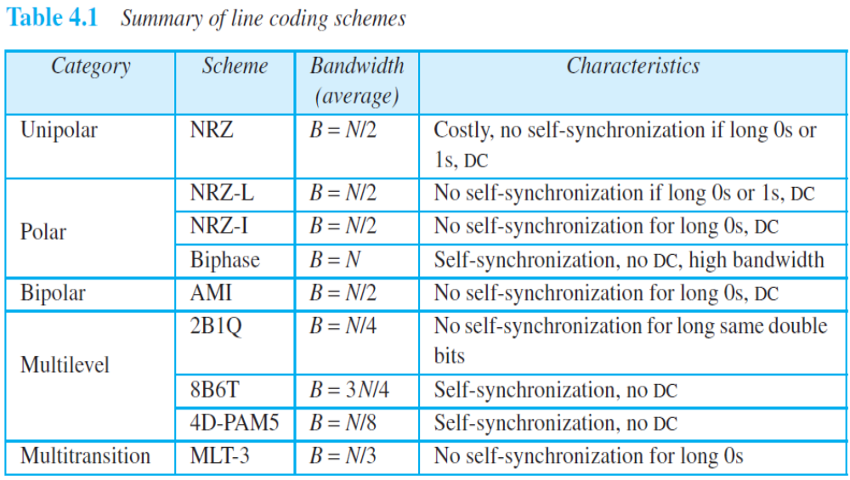
4.<number>

Slide 32
4-2 ANALOG-TO-DIGITAL CONVERSION
Topics discussed in this section:
Pulse Code Modulation (PCM)
Delta Modulation (DM)
4.<number>

Slide 33
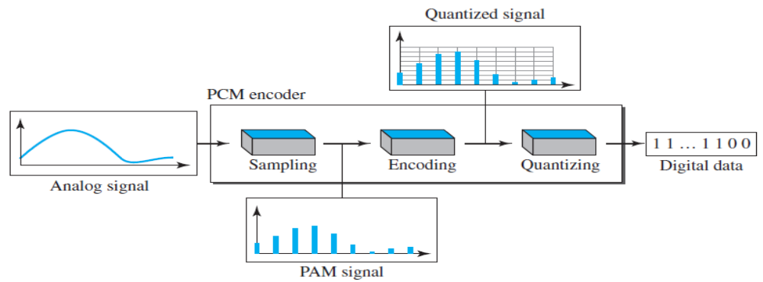
Figure 4.21 Components of PCM encoder
The most common technique to change an analog signal to digital data (digitization) is called pulse code modulation (PCM). A PCM encoder has three processes, as shown in Figure 4.21.
The analog signal is sampled.
The sampled signal is quantized.
The quantized values are encoded as streams of bits.
4.<number>

Slide 34
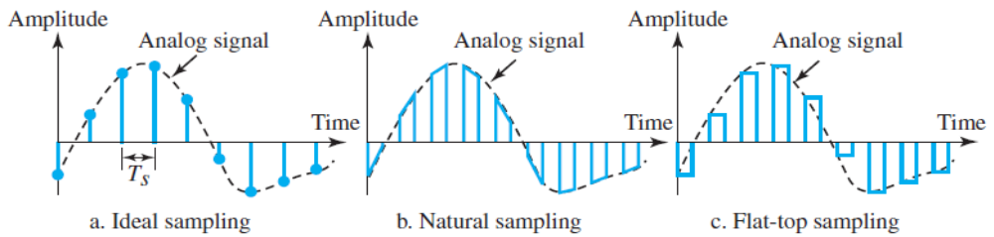
Figure 4.22 Three different sampling methods for PCM
Sampling: The first step in PCM is sampling. The analog signal is sampled every T_{s} s, where T_{s} is the sample interval or period.
The inverse of the sampling interval is called the sampling rate or sampling frequency and denoted by f_{s}, where f_{s} = 1/T_{s}. There are three sampling methods—ideal, natural, and flat-top.
In ideal sampling, pulses from the analog signal are sampled. This is an ideal sampling method and cannot be easily implemented.
In natural sampling, a high-speed switch is turned on for only the small period of time when the sampling occurs. The result is a sequence of samples that retains the shape of the analog signal.
The most common sampling method, called sample and hold, however, creates flat-top samples by using a circuit.
The sampling process is sometimes referred to as pulse amplitude modulation (PAM). We need to remember, however, that the result is still an analog signal with nonintegral values.
4.<number>

Slide 35
Sampling Rate
One important consideration is the sampling rate or frequency. What are the restrictions on T_{s}? This question was elegantly answered by Nyquist.
According to the Nyquist theorem, the sampling rate must be at least 2 times the highest frequency contained in the signal.
We need to elaborate on the theorem at this point. First, we can sample a signal only if the signal is band-limited. In other words, a signal with an infinite bandwidth cannot be sampled.
Second, the sampling rate must be at least 2 times the highest frequency, not the bandwidth.
4.<number>

Slide 36

Figure 4.23 Nyquist sampling rate for low-pass and bandpass signals
If the analog signal is low-pass, the bandwidth and the highest frequency are the same value.
If the analog signal is bandpass, the bandwidth value is lower than the value of the maximum frequency.
4.<number>

Slide 37
Example 4.6
For an intuitive example of the Nyquist theorem, let us sample a simple sine wave at three sampling rates: f_{s} = 4f (2 times the Nyquist rate), f_{s} = 2f (Nyquist rate), and
f_{s} = f (one-half the Nyquist rate). Figure 4.24 shows the sampling and the subsequent recovery of the signal.
It can be seen that sampling at the Nyquist rate can create a good approximation of the original sine wave (part a). Oversampling in part b can also create the same approximation, but it is redundant and unnecessary. Sampling below the Nyquist rate (part c) does not produce a signal that looks like the original sine wave.
4.<number>

Slide 38

Figure 4.24 Recovery of a sampled sine wave for different sampling rates
4.<number>

Slide 39
Example 4.7
Consider the revolution of a hand of a clock. The second hand of a clock has a period of 60 s. According to the Nyquist theorem, we need to sample the hand every 30 s (f_{s} = 2f (Nyquist rate)). In Figure 4.25a, the sample points, in order, are 12, 6, 12, 6, 12, and 6. The receiver of the samples cannot tell if the clock is moving forward or backward. In part b, we sample at double the Nyquist rate (every 15 s)(f_{s} = 4f (2 times the Nyquist rate)). The sample points are 12, 3, 6, 9, and 12. The clock is moving forward. In part c, we sample below the Nyquist rate (f_{s} = f (one-half the Nyquist rate)). The sample points are 12, 9, 6, 3, and 12. Although the clock is moving forward, the receiver thinks that the clock is moving backward.
4.<number>

Slide 40

Figure 4.25 Sampling of a clock with only one hand
4.<number>

Slide 41
Example 4.8
An example related to Example 4.7 is the seemingly backward rotation of the wheels of a forward-moving car in a movie. This can be explained by under-sampling. A movie is filmed at 24 frames per second. If a wheel is rotating more than 12 times per second, the under-sampling creates the impression of a backward rotation.
4.<number>

Slide 42
Example 4.9
Telephone companies digitize voice by assuming a maximum frequency of 4000 Hz. The sampling rate therefore is 8000 samples per second.
4.<number>

Slide 43
Example 4.10
A complex low-pass signal has a bandwidth of 200 kHz. What is the minimum sampling rate for this signal?
Solution
The bandwidth of a low-pass signal is between 0 and f, where f is the maximum frequency in the signal. Therefore, we can sample this signal at 2 times the highest frequency (200 kHz). The sampling rate is therefore 400,000 samples per second.
4.<number>

Slide 44
Example 4.11
A complex bandpass signal has a bandwidth of 200 kHz. What is the minimum sampling rate for this signal?
Solution
We cannot find the minimum sampling rate in this case because we do not know where the bandwidth starts or ends. We do not know the maximum frequency in the signal.
4.<number>

Slide 45
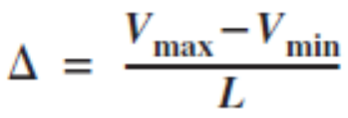
Quantization
The result of sampling is a series of pulses with amplitude values between the maximum and minimum amplitudes of the signal. The set of amplitudes can be infinite with non-integral values between the two limits. These values cannot be used in the encoding process. The following are the steps in quantization:
We assume that the original analog signal has instantaneous amplitudes between V_{min} and V_{max}.
We divide the range into L zones, each of height Δ (delta).
We assign quantized values of 0 to L − 1 to the midpoint of each zone.
We approximate the value of the sample amplitude to the quantized values.
As a simple example, assume that we have a sampled signal and the sample amplitudes are between −20 and +20 V. We decide to have eight levels (L = 8). This means that Δ = 5 V. Figure 4.26 shows this example. (Only nine samples using ideal sampling are shown for simplicity)
4.<number>

Slide 46
Quantization Levels
The choice of L, the number of levels, depends on the range of the amplitudes of the analog signal and how accurately we need to recover the signal.
If the amplitude of a signal fluctuates between two values only, we need only two levels.
If the signal, like voice, has many amplitude values, we need more quantization levels. In audio digitizing, L is normally chosen to be 256. In video it is normally thousands.
Choosing lower values of L increases the quantization error if there is a lot of fluctuation in the signal.
Quantization Error
One important issue is the error created in the quantization process.
Quantization is an approximation process. The input values to the quantizer are the real values; the output values are the approximated values.
The output values are chosen to be the middle value in the zone. If the input value is also at the middle of the zone, there is no quantization error; otherwise, there is an error.
In Figure 4.26, the normalized amplitude of the third sample is 3.24, but the normalized quantized value is 3.50. This means that there is an error of +0.26.
The error value for any sample is less than Δ/2. In other words, we have −Δ/2 ≤ error ≤ Δ/2.
The quantization error changes the signal-to-noise ratio of the signal, which in turn reduces the upper limit capacity according to Shannon.
The contribution of the quantization error to the SNR_{dB} of the signal depends on the number of quantization levels L, or the bits per sample n_{b}, as
SNR_{dB} = 6.02n_{b} + 1.76 dB

Slide 47

Figure 4.26 Quantization and encoding of a sampled signal
Note: quantization code for each sample based on the quantization levels at the left of the graph.
4.<number>

Slide 48
Example 4.12
What is the SNRdB in the example of Figure 4.26?
Solution
We can use the formula to find the quantization. We have eight levels and 3 bits per sample, so
SNRdB = 6.02(3) + 1.76 = 19.82 dB
Increasing the number of levels increases the SNR.
4.<number>

Slide 49
Example 4.13
A telephone subscriber line must have an SNRdB above 40. What is the minimum number of bits per sample?
Solution
We can calculate the number of bits as
Telephone companies usually assign 7 or 8 bits per sample.
4.<number>

Slide 50
PCM Encoder
The last step in PCM is encoding. After each sample is quantized and the number of bits per sample is decided, each sample can be changed to an n_{b}-bit code word. In Figure 4.26 the encoded words are shown in the last row.
Note that the number of bits for each sample is determined from the number of quantization levels. If the number of quantization levels is L, the number of bits is n_{b} = log₂ L. In our example L is 8 and n_{b} is therefore 3. The bit rate can be found from the formula
Bit rate = sampling rate x number of bits per sample = f_{s} x n_{b}
4.<number>

Slide 51
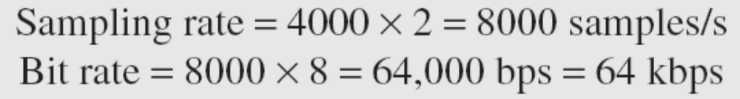
Example 4.14
We want to digitize the human voice. What is the bit rate, assuming 8 bits per sample?
Solution
The human voice normally contains frequencies from 0 to 4000 Hz. So the sampling rate and bit rate are calculated as follows:
Bit rate = sampling rate x number of bits per sample = f_{s} x n_{b}
4.<number>

Slide 52

Figure 4.27 Components of a PCM decoder
The decoder first uses circuitry to convert the code words into a pulse that holds the amplitude until the next pulse. After the staircase signal is completed, it is passed through a low-pass filter to smooth the staircase signal into an analog signal.
The filter has the same cutoff frequency as the original signal at the sender.
If the signal has been sampled at (or greater than) the Nyquist sampling rate and if there are enough quantization levels, the original signal will be recreated.
Note that the maximum and minimum values of the original signal can be achieved by using amplification. Figure 4.27 shows the simplified process.
4.<number>

Slide 53
PCM Bandwidth
Suppose we are given the bandwidth of a low-pass analog signal. If we then digitize the signal, what is the new minimum bandwidth of the channel that can pass this digitized signal? We have said that the minimum bandwidth of a line-encoded signal is B_{min} = c × N × (1/r). We substitute the value of N in this formula:
B_{min} = c × N × (1/r) = c × f_{s} x n_{b} × (1/r) = c × n_{b} × 2 x B_{analog} × (1/r)
When 1/r = 1 (for a NRZ or bipolar signal) and c = (1/2) (the average situation), the minimum bandwidth is
B_{min} = n_{b} × B_{analog}
This means the minimum bandwidth of the digital signal is n_{b} times greater than the bandwidth of the analog signal. This is the price we pay for digitization.
4.<number>

Slide 54
Example 4.15
We have a low-pass analog signal of 4 kHz. If we send the analog signal, we need a channel with a minimum bandwidth of 4 kHz. If we digitize the signal and send 8 bits per sample, we need a channel with a minimum bandwidth of 8 × 4 kHz = 32 kHz.
4.<number>

Slide 55

Figure 4.28 The process of delta modulation
PCM is a very complex technique. Other techniques have been developed to reduce the complexity of PCM. The simplest is delta modulation.
PCM finds the value of the signal amplitude for each sample; DM finds the change from the previous sample. Figure 4.28 shows the process.
Note that there are no code words here; bits are sent one after another.
4.<number>

Slide 56

Figure 4.29 Delta modulation components
The modulator is used at the sender site to create a stream of bits from an analog signal.
The process records the small positive or negative changes, called delta δ. If the delta is positive, the process records a 1; if it is negative, the process records a 0.
However, the process needs a base against which the analog signal is compared.
The modulator builds a second signal that resembles a staircase.
The modulator, at each sampling interval, compares the value of the analog (input) signal with the last value of the staircase signal. If the amplitude of the analog signal is larger, the next bit in the digital data is 1; otherwise, it is 0.
Note that we need a delay unit to hold the staircase function for a period between two comparisons.
4.<number>

Slide 57

Figure 4.30 Delta demodulation components
4.<number>

Slide 58
4-3 TRANSMISSION MODES
The transmission of binary data across a link can be accomplished in either parallel or serial mode. In parallel mode, multiple bits are sent with each clock tick. In serial mode, 1 bit is sent with each clock tick. While there is only one way to send parallel data, there are three subclasses of serial transmission: asynchronous, synchronous, and isochronous.
Topics discussed in this section:
Parallel Transmission
Serial Transmission
4.<number>

Slide 59

Figure 4.31 Data transmission and modes
4.<number>

Slide 60

Figure 4.32 Parallel transmission
4.<number>

Slide 61

Figure 4.33 Serial transmission
4.<number>

Slide 62
Asynchronous Transmission
Asynchronous transmission is so named because the timing of a signal is unimportant. Instead, information is received and translated by agreed upon patterns. As long as those patterns are followed, the receiving device can retrieve the information without regard to the rhythm in which it is sent. Patterns are based on grouping the bit stream into bytes. Each group, usually 8 bits, is sent along the link as a unit.
Without synchronization, the receiver cannot use timing to predict when the next group will arrive. To alert the receiver to the arrival of a new group, therefore, an extra bit is added to the beginning of each byte.
The start and stop bits and the gap alert the receiver to the beginning and end of each byte and allow it to synchronize with the data stream.
In asynchronous transmission, we send 1 start bit (0) at the beginning and 1 or more stop bits (1s) at the end of each byte. There may be a gap between each byte.
Asynchronous here means “asynchronous at the byte level,” but the bits are still synchronized; their durations are the same.
4.<number>

Slide 63

Figure 4.34 Asynchronous transmission
4.<number>

Slide 64

Figure 4.35 Synchronous transmission
In synchronous transmission, the bit stream is combined into longer “frames,” which may contain multiple bytes. Each byte, however, is introduced onto the transmission link without a gap between it and the next one. It is left to the receiver to separate the bit stream into bytes for decoding purposes.
In synchronous transmission, we send bits one after another without start or stop bits or gaps. It is the responsibility of the receiver to group the bits.
4.<number>

